Slide 1
The Importance of Drag
Eric LeVally
Pacific University

Slide 2
The Project
Titan II Missile
Shooting Method
Drag vs No Drag
Interception Time
Small Drag Change

Slide 3
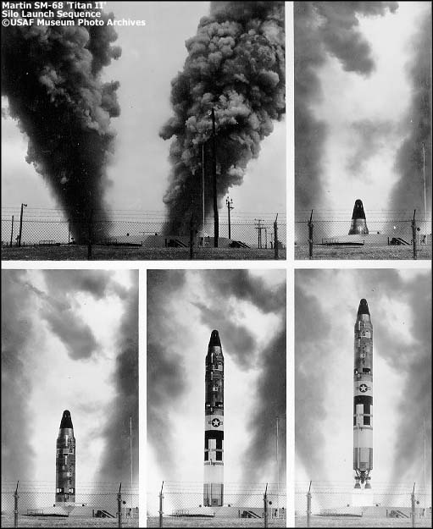
The Titan II Missile
1963 - 1987
6,706 m/s
31.4 m
15,000 km
185 km

Slide 4
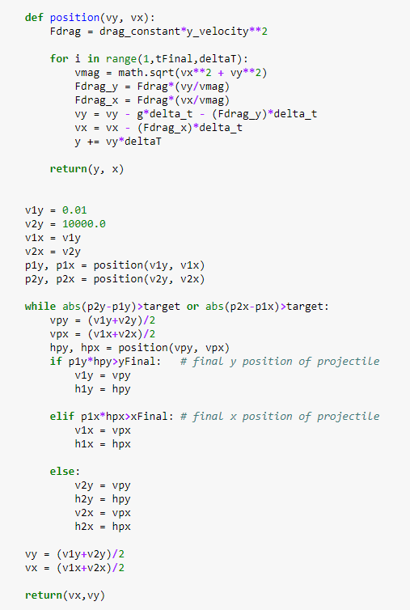
Shooting Method
4th Order Runge-Kutta Method
Bisection Method
Euler Method
The guess and check method

Slide 5
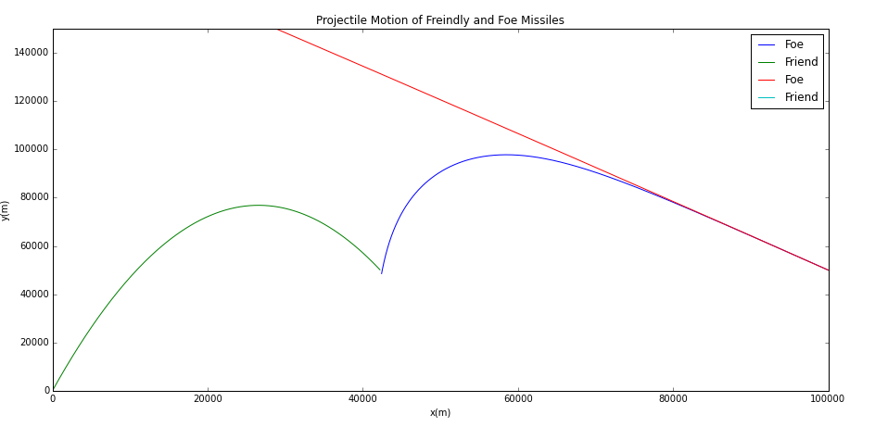
Drag vs No Drag
X Velocity Unaffected by Drag
Nearly linear

Slide 6
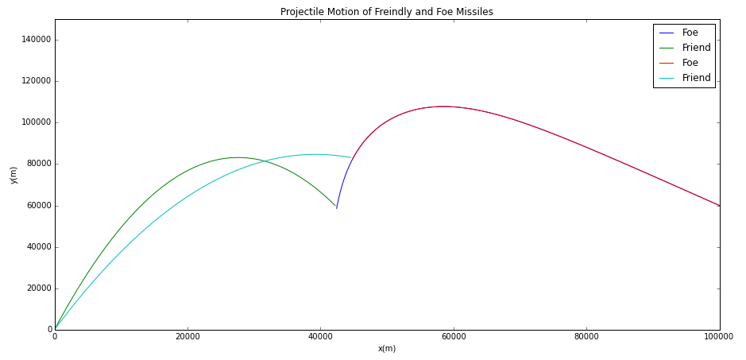
Interception Time
50 extra seconds
20 km and 5 km

Slide 7
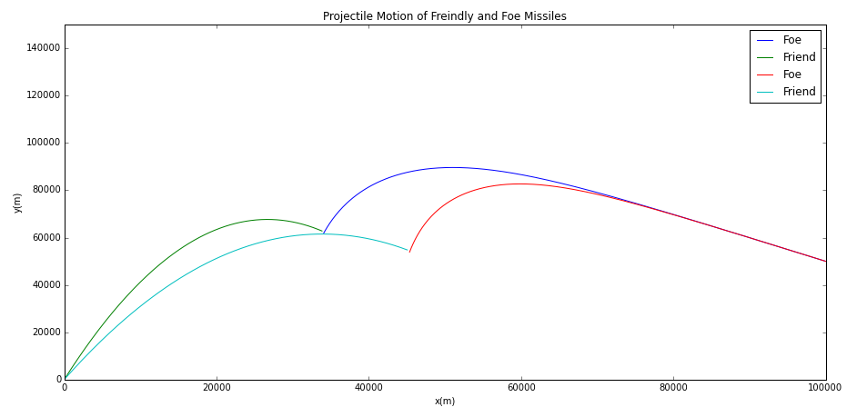
Small Drag Changes
From 4 to 5
1.5 km and 15 km

Slide 8
References and Acknowledgements
[1] Giordano, Nicholas J, and Hisao Nakanishi. Computational Physics. Dorling Kindersky. 2006
[2] M. E. J. Newman, Computational physics (Createspace, S.l., 2013).
[3] The Titan Missile (U.S. National Park Service). National Parks Service Available at: https://www.nps.gov/articles/titan-icbm.htm. (Accessed: 13th May 2018)
[4] TheMilitaryStandard - Titan II. Williams Air Force Base (AFB), Arizona Available at: http://www.themilitarystandard.com/missile/titan2/specs.php. (Accessed: 13th May 2018)
[5] Titan II. Terrier Oriole Available at: http://www.astronautix.com/t/titanii.html. (Accessed: 13th May 2018)
[6] Dr. Danielle McDermott

